Slide 1
Lecture 1: Preliminaries
Intro to Data Science for Public Policy
Jeff Chen + Dan Hammer

Slide 2
Roadmap
A Story
Framework
Course Roadmap and Structure
Hands-On Time
Getting familiar with R
Intro to Data Science for Public Policy, Spring 2018

Slide 3
An Opening Story
Intro to Data Science for Public Policy, Spring 2018
Notes:
Ask what they think data science is?

Slide 4
Credit: Nicholas Buer
Notes:
And I know what you’re thinking. This guys about to start talking about how he has a galactic mission. But not quite. Let me see a show of hands: Who here has seen the milky way?
Most people haven’t likely seen it. In fact about 80% of people live in light polluted areas. The last time I had a view was when I was 13 on a trip to Australia. And ever since then, not on the taxpayer’s dime, I’ve been a man on a mission to take a photo of the milky way.

Slide 5
Where is the best place to photograph the
Milky Way?
Credit: Nicholas Buer
Notes:
And I know what you’re thinking. This guys about to start talking about how he has a galactic mission. But not quite. Let me see a show of hands: Who here has seen the milky way?
Most people haven’t likely seen it. In fact about 80% of people live in light polluted areas. The last time I had a view was when I was 13 on a trip to Australia. And ever since then, not on the taxpayer’s dime, I’ve been a man on a mission to take a photo of the milky way.

Slide 6
Cloudiness in Death Valley
Death Valley
California
Notes:
So, I’ve dragged my wife along with me around the country to the most remote, darkest places. And in retrospect, they were borderline poor life decisions. A few years ago, we went to Death Valley (which is quite pretty) and waited around until sunset (which is quite romantic)

Slide 7
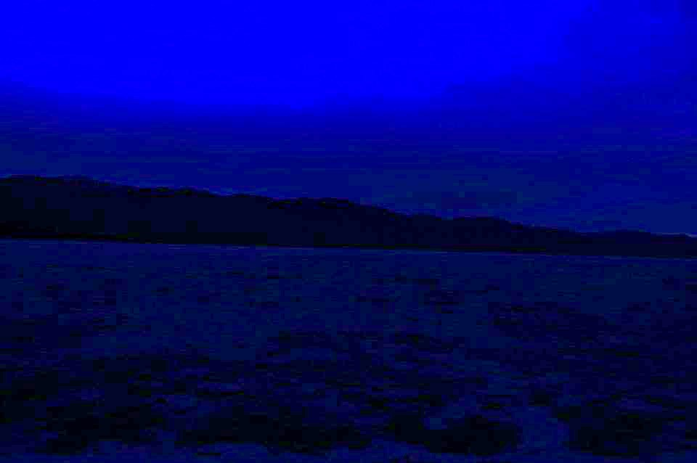
Cloudiness in Death Valley
Death Valley at night with clouds
Notes:
Little did we realize, if we had checked the historical cloud coverage, we would have known that we had little chance of seeing stars at that time of the year. And so, in a place without lights or anyone around for miles, we ended up driving for 2 hours in the pitch darkness, in the desert, hoping that we wouldn’t find Elvis. Needless to say, we were freaking out.

Slide 8
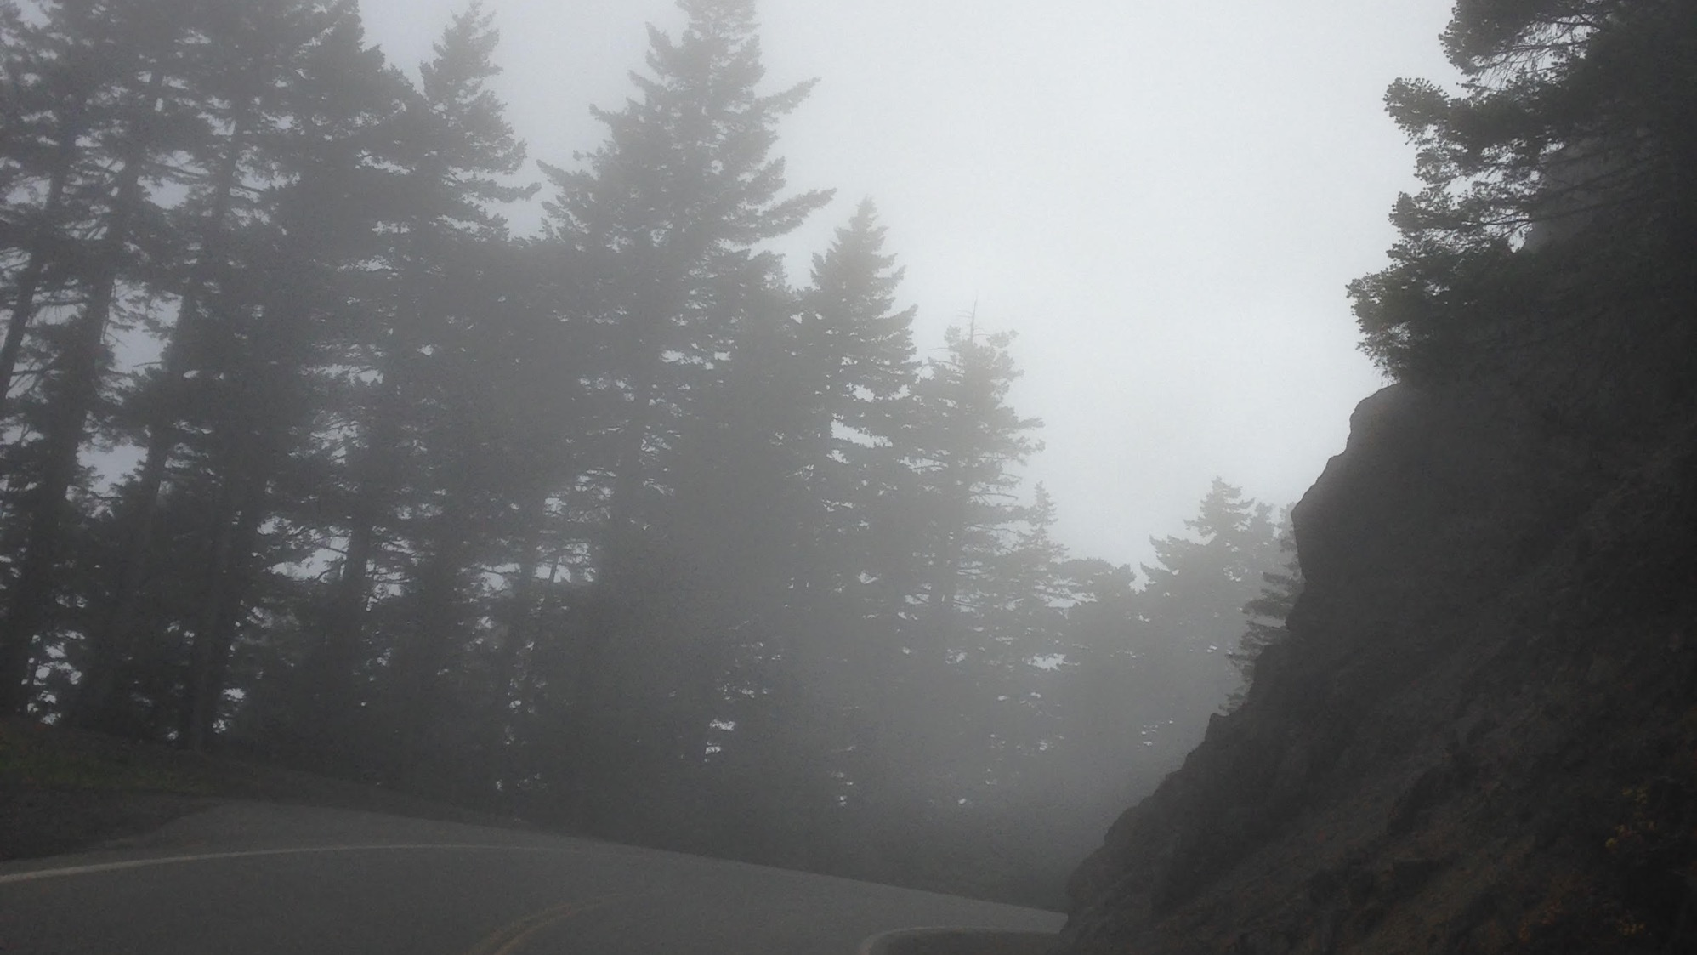
Olympic National Park
Washington State
Notes:
This year, we drove up to Hurricane Ridge in Olympic National Park in Washington State. And on the way up, we drove through about 500 vertical feet of clouds – felt awfully like a Twlight movie.

Slide 9
Hurricane Ridge
(so far, so good)
Notes:
And we got to Hurricane Ridge (which like all national parks is quite pretty) and waited around until sunset (which is quite romantic). Bu

Slide 10
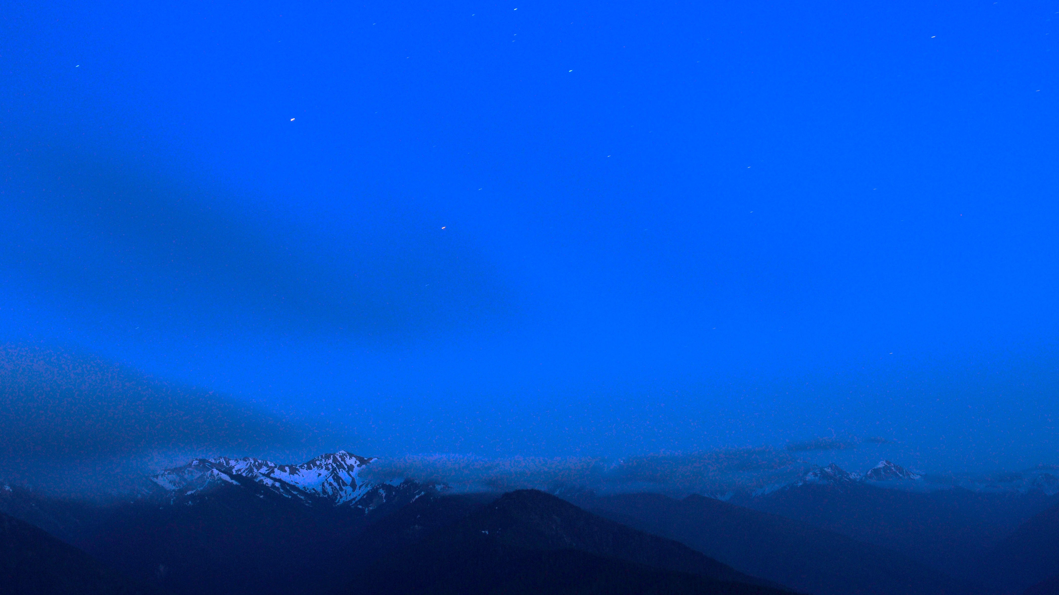
Almost had a bad accident in the mist of Olympic national park coming down from Hurricane Ridge
Hurricane Ridge
(not so good)
Notes:
t what I didn’t take into account was the brightness – it really doesn’t get dark in the Pacific Northwest in the summer. Then clouds crept in. So we abandoned mission, but little did we realize that the same 500 vertical feet of cloud cover on the roadway would still be there and we had to navigate it on a road 5000 feet above sea level without the protection of a guard rail.
Needless to say, there was a decent amount of freaking out.

Slide 11
**Re-Evaluated Strategy**
Where is the best place to photograph the Milky Way?
Where is an accessible place to photograph the Milky Way?
Notes:
So this led me to re-evaluate a month ago. I’m a data geek, so I decided to turn to data to estimate the probability of minimal freak out or MFO. And I figured it’d be the combination of having dark enough skies so that we’re not in the most random isolated place, it’s close enough to where I live so I wouldn’t have to drive really far, and the skies are clear

Slide 12
**Re-Evaluated Strategy**
Pr(Minimal Freak Out) =
Pr(Poor Good Life Decision)=
f(Dark enough,
Close by,
Clear skies)
Notes:
So this led me to re-evaluate. I’m a data geek, so I decided to turn to data to estimate the probability of minimal freak out or MFO. And I figured it’d be the combination of having dark enough skies so that we’re not in the most random isolated place, it’s close enough to where I live so I wouldn’t have to drive really far, and the skies are clear

Slide 13
To be able to look up, we need to first look down.
Notes:
If you were to engineer the measurements to calculate that, you would find that looking up is just about the same as looking down.

Slide 14
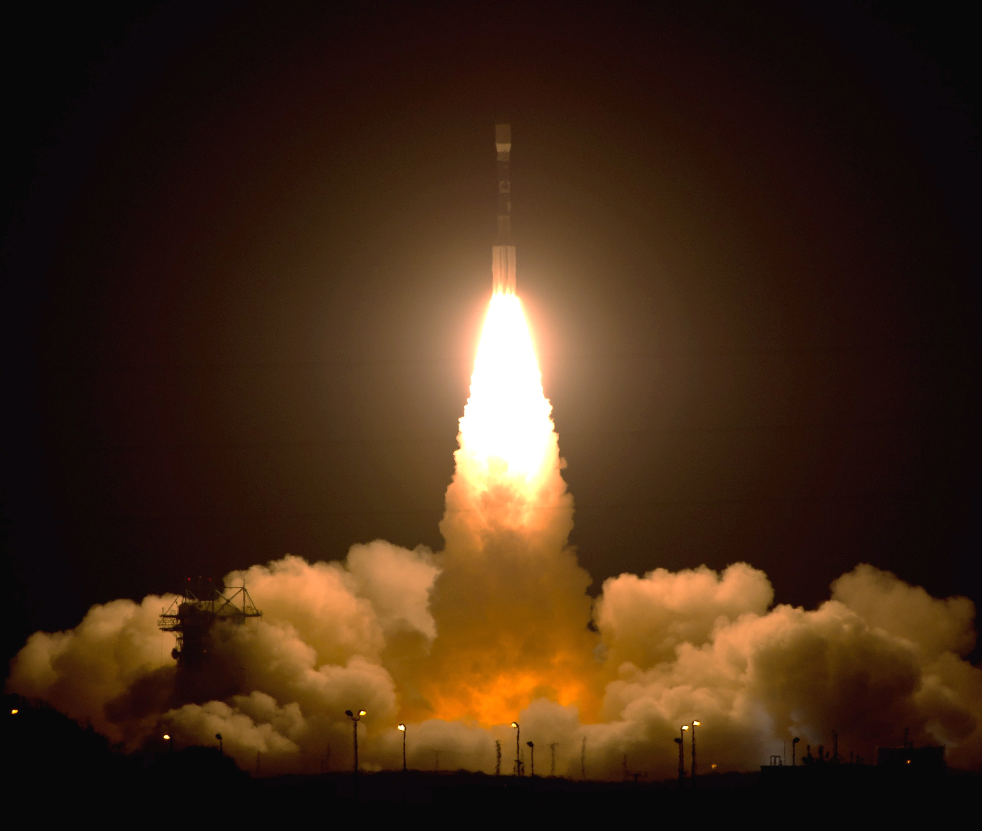
Notes:
And as it turns out, in 2011, this Delta II rocket took off from Vandenberg Air Force Base in California.

Slide 15
Notes:
Onboard was the Suomi NPP satellite, a nearly 2000 kg satellite with the mission of adding to the environmental and climate data records of our blue marble and to better understand society. The satellite mission was made possible by a partnership between the National Oceanic and Atmospheric Administration (NOAA) and NASA.

Slide 16
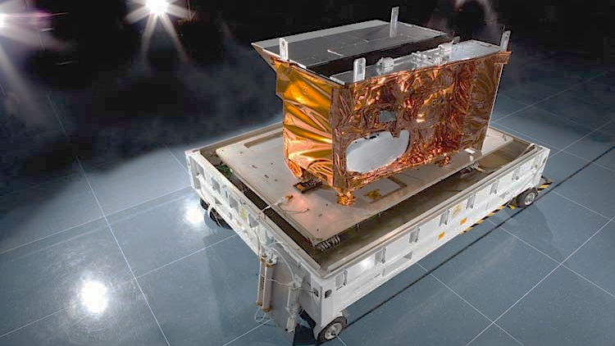
Notes:
Onboard, NPP carries various instruments that collect information about the earth system. One particular instrument, the Visible Infrared Imaging Radiometer Suite or VIIRS -- a 277 kg imaging device -- holds the potential to understand earth in unprecedented ways.

Slide 17
Notes:
As a result of 1 instrument on this satellite platform, we collect about 2.5 Terabytes of data per day that could tell us about everything under the sun. Including nighttime lights.

Slide 18
~518 million pixels
or potential locations

Slide 19
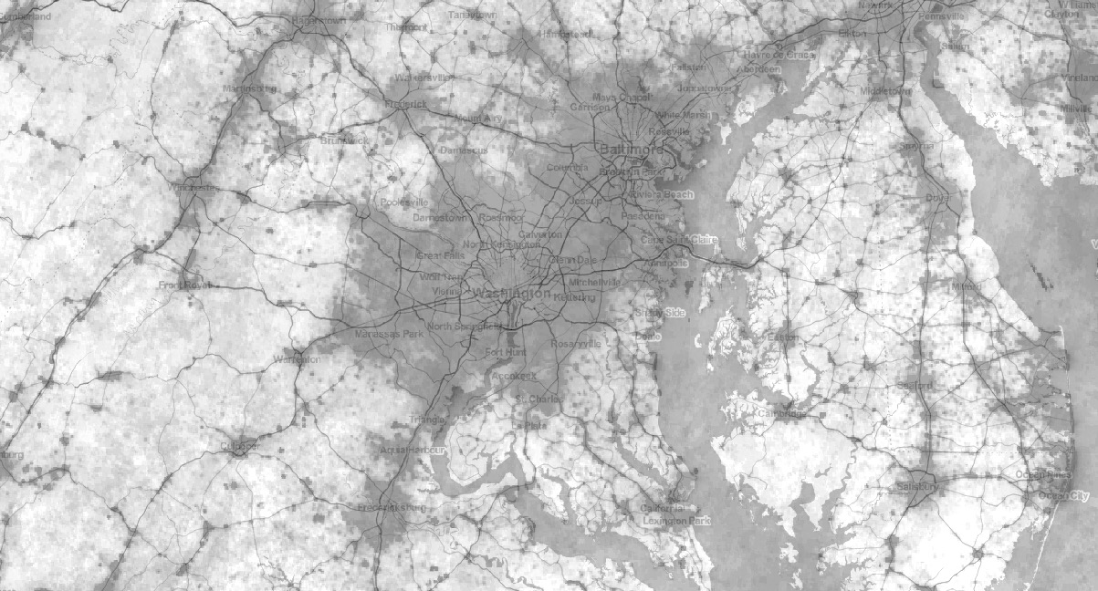
~15 million pixels in the DC region

Slide 20
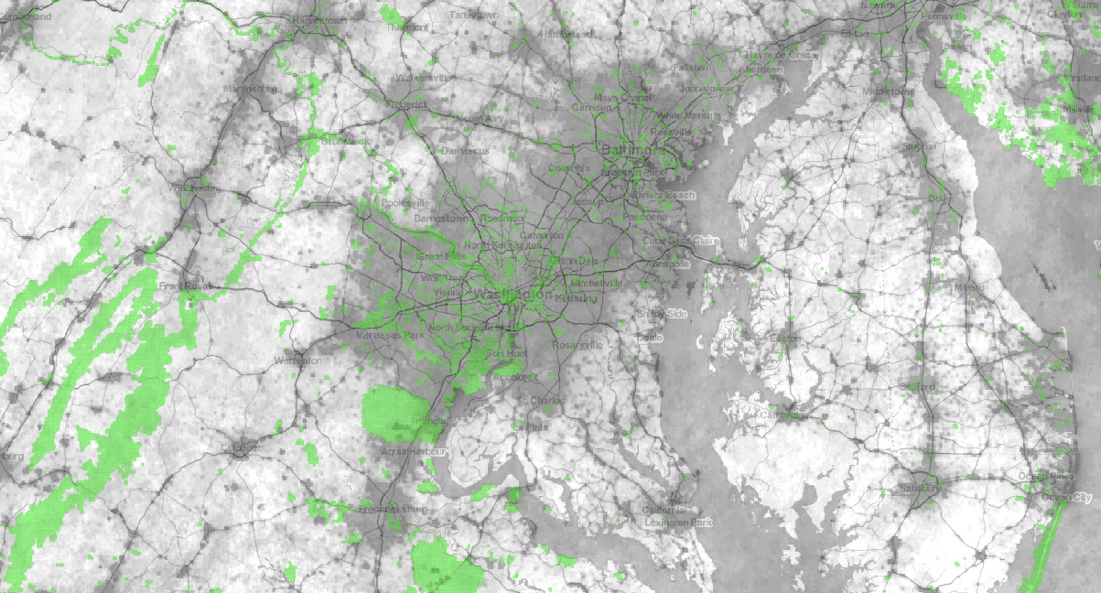
~152,000 pixels in parklands

Slide 21
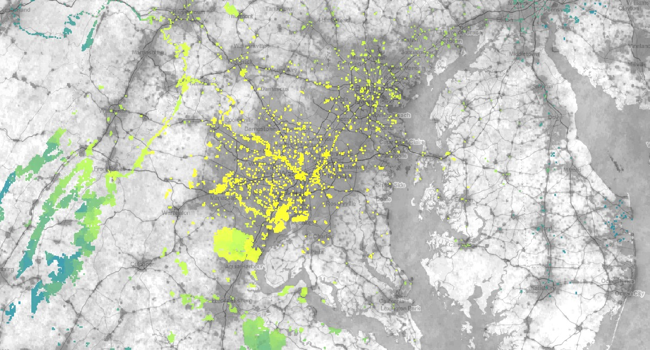
Close by

Slide 22
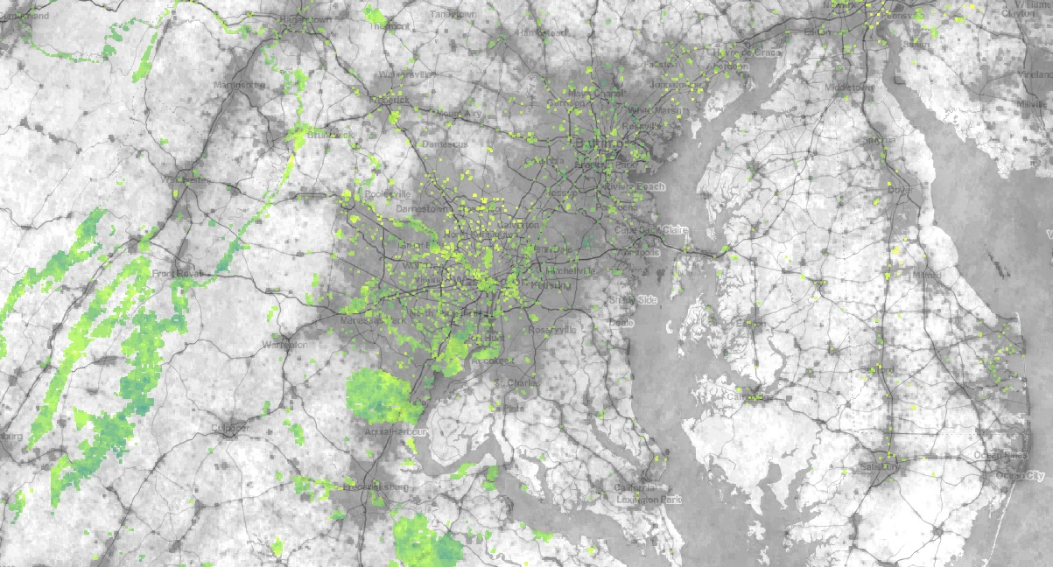
Clear skies

Slide 23
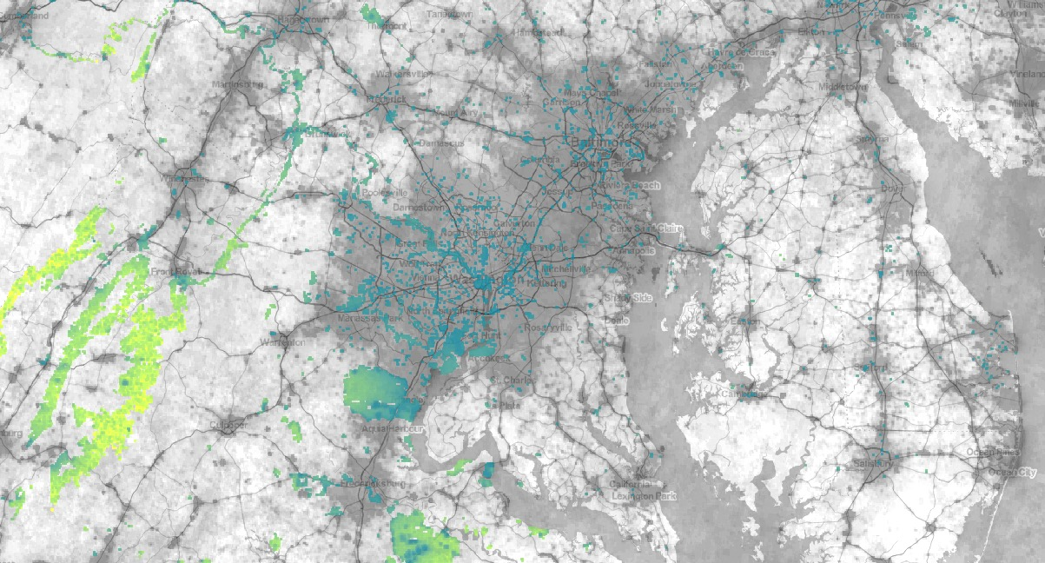
Dark Enough

Slide 24
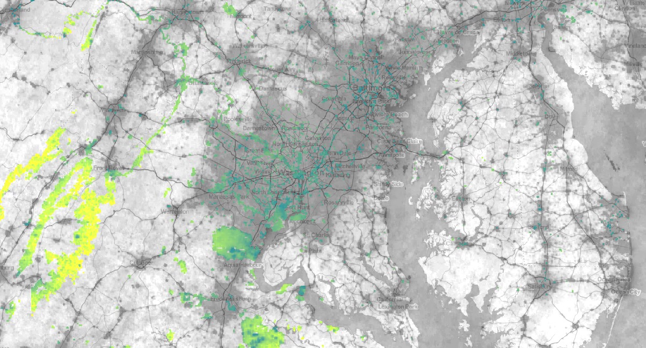
Shenandoah Nat’l Park
Pr(MFO)

Slide 25
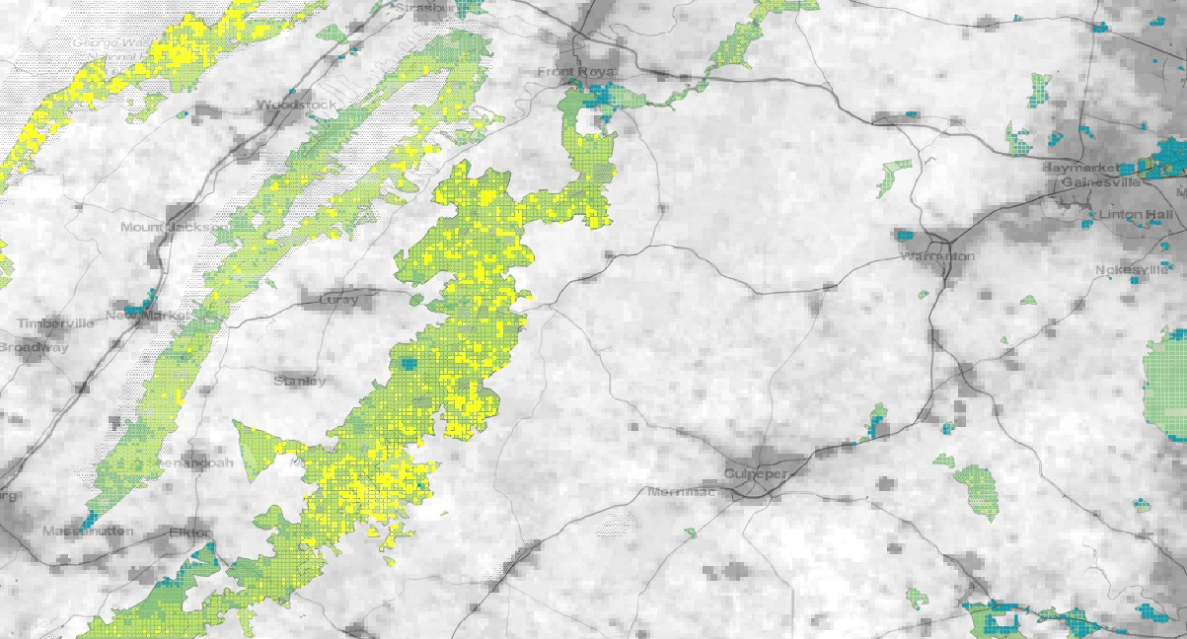
Skyland
Big Meadows
Notes:
This led to identifying two key areas in Shenandoah National Park. K

Slide 26
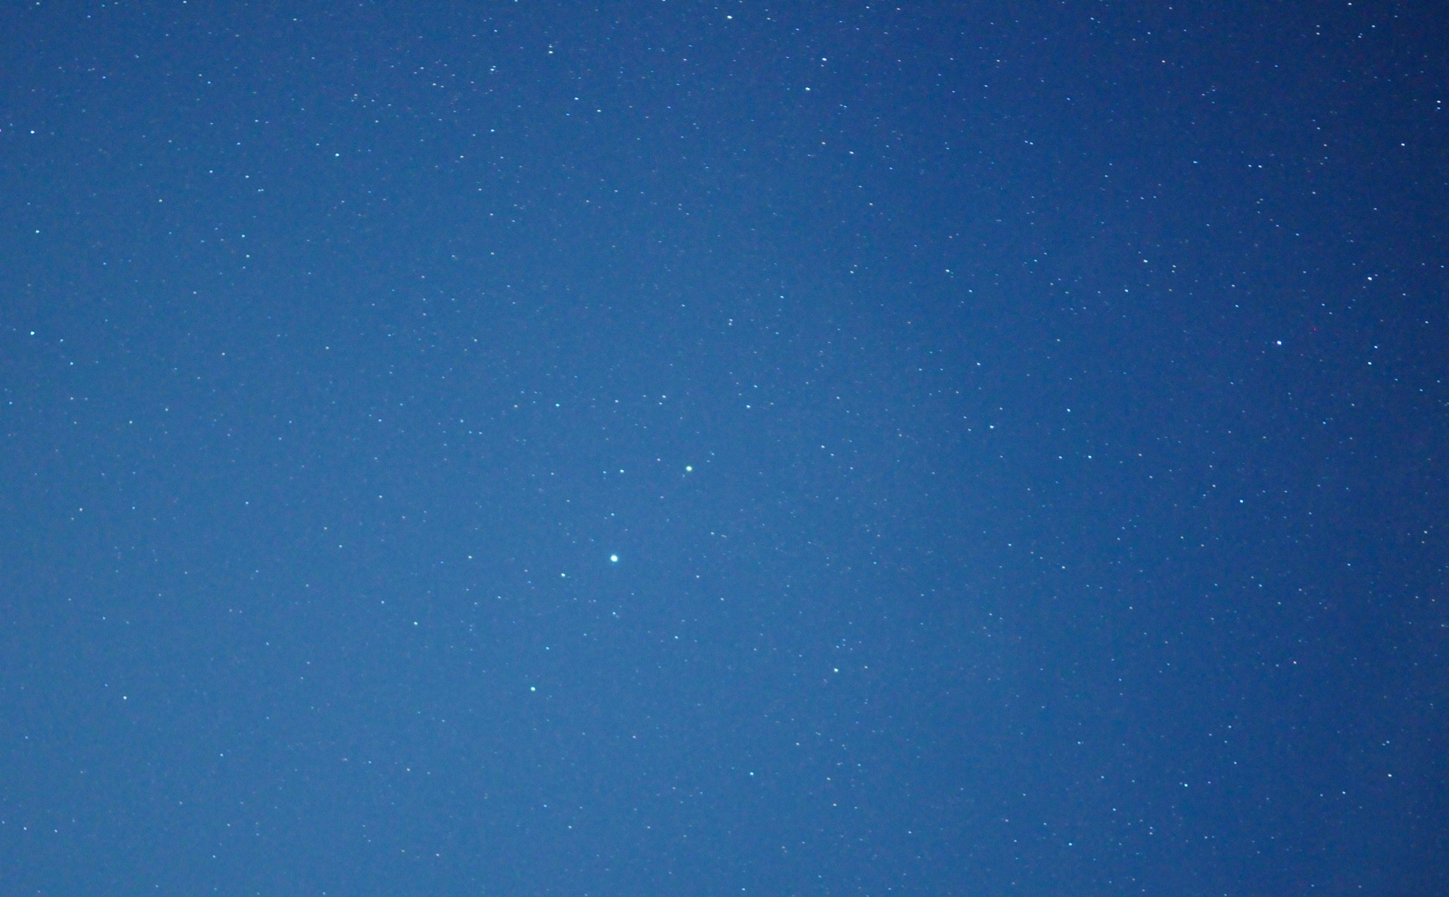
Attempt #1 @ Skyland
Shenandoah National Park
Notes:
We could see stars, but we were within a couple miles of a town. The result is just generic speckles.

Slide 27
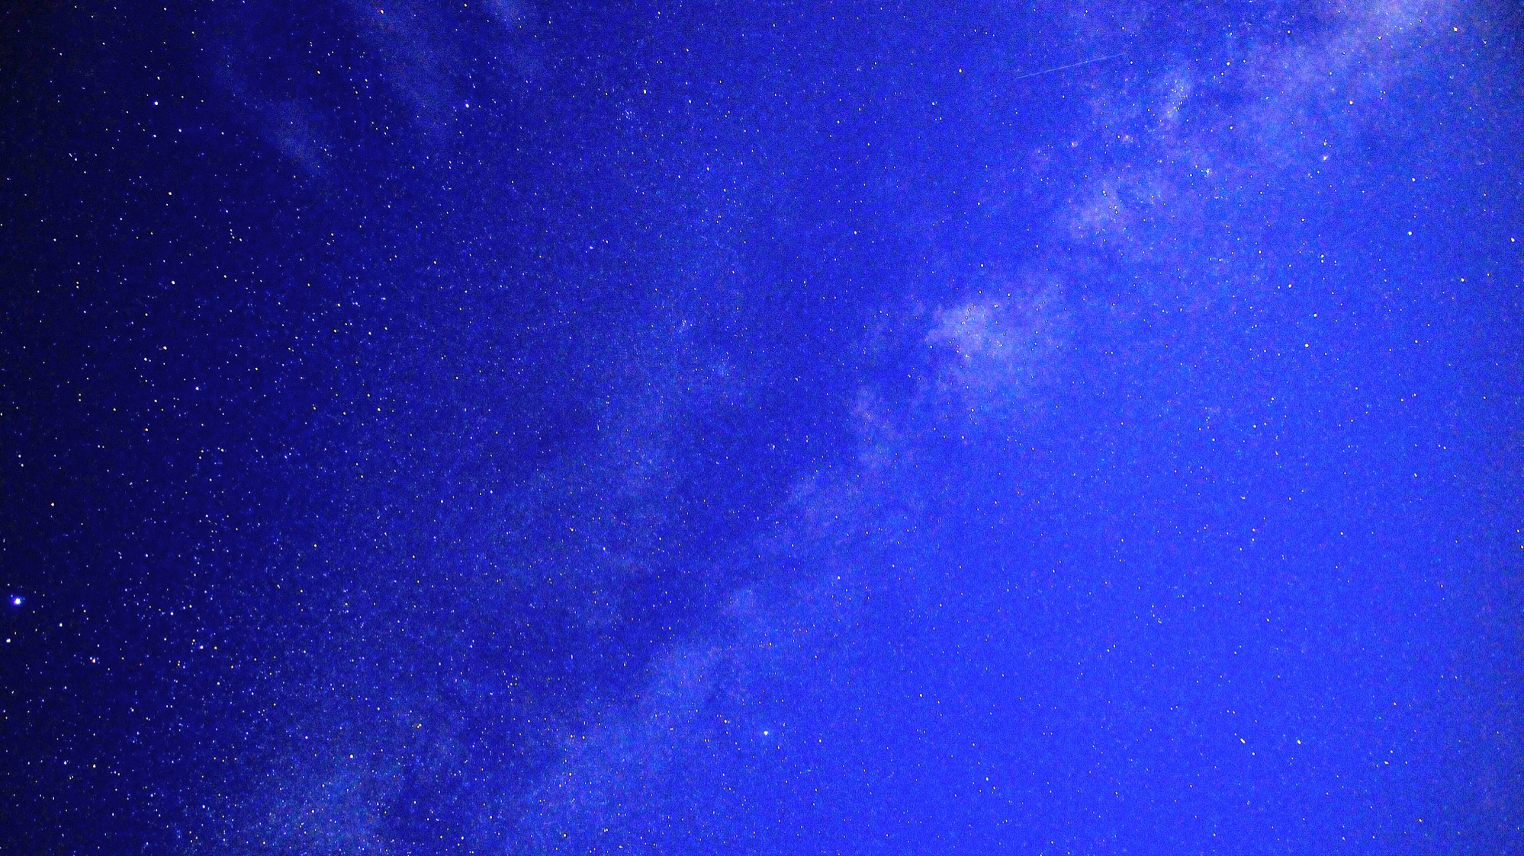
Attempt #2 @ Big Meadows
Shenandoah National Park
Notes:
The following night, we went to the middle of the big meadows. The thing is that you sometimes will see the milky way but it legit looks like a bunch of clouds that get brighter. And Brighter. And then Ouala. And with a 15second exposure on a 17mm at f/2.8, you can get your very own shot of the Milky Way. It’s a pretty magnificent thing as some of these stars are hundreds of thousands of light years away, spending the better part of a million years traveling to earth.

Slide 28
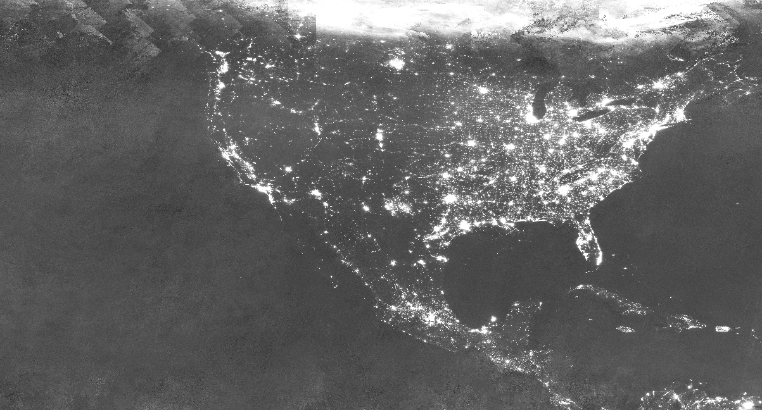
One dataset coupled with data science can enable dozens of new field-deployed capabilities beyond its original intended purpose.
RECREATION. Function for finding dark sky locations for stargazing.
SOCIOECONOMIC. Estimating more timely population and poverty estimates for developing parts of the world (Chen & Norhaus, 2015), (Jean, Luo & Kim, 2016)
FISHERIES. Monitoring illegal nighttime fishing in Indonesia (Elvidge et al., 2015)
ENERGY. Monitoring natural gas flares from petrochemical extraction (Elvidge et al., 2016)
VIIRS DNB Imagery
FIRES. Identifying wildfires as they start and spread (NASA, 2015)
STORMS. Spotting blackouts due to storm impacts (NASA, 2012)
Intro to Data Science for Public Policy, Spring 2018
Notes:
Talk about examples

Slide 29
What skills were required to make the Milky Way example a reality?
Intro to Data Science for Public Policy, Spring 2018
Notes:
Ask class for thoughts?

Slide 30
Ask a data-enabled question
Convert the question into quantifiable parameters (e.g. universe, variables)
Obtain any form of data and understand what it is
Store the data in a re-usable efficient form
Transform any type of data from one form to another
Relate multiple features to one another
Optimize or prioritize values based on some function
Provide human interpretable results that have a narrative that is approachable
Intro to Data Science for Public Policy, Spring 2018
Notes:
Ask class for thoughts?

Slide 31
Roadmap
A Story
Framework
Course Roadmap and Structure
Hands-On Time
Getting familiar with R
Intro to Data Science for Public Policy, Spring 2018

Slide 32
What is data science?!
Many have tried to define it, but there isn’t perfect consensus.
Intro to Data Science for Public Policy, Spring 2018

Slide 33
What is data science?!
What is it used for?
What goes into it?
Intro to Data Science for Public Policy, Spring 2018

Slide 34

What is it used for?
Intro to Data Science for Public Policy, Spring 2018

Slide 35
What is it used for?
benchmarking helps to contextualize the current state relative to a reference point. The reference point gives context over time and space to illustrate a trend or can be used to show relative performance.
What was the monthly unemployment rate last month?
What are SAT Scores for Georgetown?
What is my speed now on my speedometer?
Intro to Data Science for Public Policy, Spring 2018

Slide 36
What is it used for?
Explain how things work, or at least quantify relationships between observed phenomena (e.g. dependent variables or target features) and their associated characteristics (e.g. independent variables or input features)
What determines the housing sales prices?
What caused a drop in crime?
Intro to Data Science for Public Policy, Spring 2018

Slide 37
What is it used for?
Prediction ventures to make empirical guesses about what will happen next before knowing what happens.
Which products/movies do you want to buy/watch?
Which candidate will you likely vote for and are you swingable?
Will there be a fire in this building tomorrow?
Intro to Data Science for Public Policy, Spring 2018

Slide 38
What goes into data science?!
Many have tried to define it, but there isn’t perfect consensus. But generally it involves the following:
measurement + experimental design
[computer] programming
mathematics + statistics
communications
Intro to Data Science for Public Policy, Spring 2018

Slide 39
Measurement + Experimental Design
Concepts and considerations that feed into this dimension of data science
Data collection
Estimation strategy
Operations and process design
Quantitative evaluation design
Algorithm performance
Train/Validate/Test, K-folds cross validation
Intro to Data Science for Public Policy, Spring 2018

Slide 40
Computer programming
Concepts and considerations that feed into this dimension of data science
Languages: Python, R, Julia, SQL
Control structures
Feature engineering
Algorithm design
APIs and web services
Database architecture
High performance computation
Extract-Transform-Load
Intro to Data Science for Public Policy, Spring 2018

Slide 41
Mathematics + Statistics
Concepts and considerations that feed into this dimension of data science
Machine learning: supervised and unsupervised
Error functions and objective functions
Information theory
Frequentist and Bayesian Statistical Theory
Probability density functions
Matrix and linear algebra
Vector calculus
Combinatorics
Intro to Data Science for Public Policy, Spring 2018

Slide 42
Communications
Concepts and considerations that feed into this dimension of data science
Visualization
Interactives
Data storytelling
Consensus building
Productizing data
What is data science?!

Slide 43
Roadmap
A Story
Framework
Course Roadmap and Structure
Hands-On Time
Getting familiar with R

Slide 44
Course goals [tangibles]
Great data-driven policy only is great when it is implemented.
Otherwise, it’s still just an idea. This is a course about planning and executing, focusing on employable technical skills.
Be able to write a predictive function from scratch
Design and implement a small data science project, including sample design, ETL, and visualization
Diagnose how a data science project can fit into a policy process
Walk away with a project that is non-standard
Course design

Slide 45
Course structure
Jan 11
May 1
data science design
programming
Math + stats
Comms
Unit #1
Unit #2
Unit #3
Course design

Slide 46
Course structure
Emphasis on data science throughout the course
Jan 11
May 1
data science design
programming
math + stats
Comms
Focus on building strength in ‘skilled assembly’
Unit #1
Unit #2
Unit #3
Higher-level presentation saved for later
Fun stuff introduced when programming skills are built up
Course design

Slide 47
Play-by-Play: Programming Basics
By Lecture
Preliminaries and Intro to R
Control Structures, I/O, Indices, Functions and Etiquette
Data Manipulation / Wrangling / Feature Engineering
Exploratory Data Analysis
Topics

Slide 48
Play-by-Play: Data Analysis + Modeling
By Lecture
Intro to Supervised Learning: Continuous Models
…continued
Classification Techniques
…continued
Unsupervised Learning: K-Means and PCA
Other Techniques
Topics

Slide 49
Play-by-Play: Greater Context
By Lecture
Data Products
SQL and Python
The Bigger Picture
Topics
Notes:
I’m thinking about swapping out data storytelling with another session of supervised learning, but it really depends on the pre-class survey results

Slide 50
Assignments
Jan 15
May 1
Problem sets
#1
#2
#3
#4
#5
#6
Final project
Projects
Weight
60%
40%
Penalization
10% off per day late
Assignments

Slide 51
Typical class structure
Part 0:
Review homework [if there was one]
Part 1:
The big picture story, the technical theory, use cases
Part 2:
Code-along – solidify
Class structure

Slide 52
Roadmap
A Story
Framework
Course Roadmap and Structure
Hands-On Time
Getting familiar with R

Slide 53
Coverage
Rstudio console
Rmarkdown
Basic functions in R
Assignments

Slide 54
To Do For Next Class
Github.com/georgetownmccourt/data-science
Read Chapters 1 and 2 at: https://georgetownmccourt.github.io/data-science/
Complete the exercises at the end of Chapter 1
Assignments

Slide 55
Last word of wisdom: Things I look for in a data scientist
Ability to code
Can be demonstrated by having an original set of code projects on Github that involves original algorithms
Ability to communicate
Can articulate the business case (visuals, documentation)
Ability to scope
Can figure out the point of the problem (narratives)
Class structure

